Slide 1


Scalable and Customizable Intent Inference and Motion Planning for Socially-Adept Autonomous Vehicles
ACC 2022 Workshop on Human-Autonomy Interaction and Integration
Sunny Amatya Robotics and Intelligent Systems Laboratory,
The Polytechnic School,
Arizona State University
June 7th, 2022

Slide 2
Notes:
The video here shows an AV trying to merge onto the highway. While the human car behind it successfully did so, the AV failed to do so. Notice that it is not that the human cars are being inconsiderate and not allowing the merge to happen. You can in fact notice that the human cars all slowed down, expecting the AV to merge. Yet the machine failed to understand the intent of the humans. Hence we can see that AVs fail to understand human intents in real time and with safety guarantee.

Slide 3
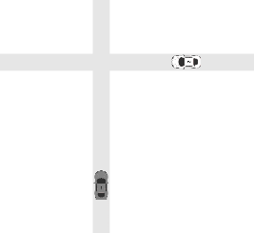

Autonomous Driving as Incomplete Information Game
Interaction between Human and AV is general-sum dynamic game with incomplete information.
The game can be solved by (1) parameter estimation and (2) motion planning.
Computing Perfect Bayesian Equilibrium (PBE) in real time is computationally expensive
Key Question
Is empathy advantageous?
Do we need to run the intent inference at the same frequency as motion planning?
Planning according to the estimates:
Aggressive?
?
Human
?
Joint Prob. (ΘxΘ) | Aggressive | Non-aggressive
Aggressive | 0.1 | 0.5
Non-aggressive | 0.3 | 0.1
AV
Notes:
Once the beliefs are updated through the inference, motion planning is performed to advance in the interaction

Slide 4
What is empathy?
Existing work often assume the robot’s (ego agent’s) parameters are known by the human!
i.e., the robot does not acknowledge human’s misunderstanding of its parameters, thus the robot is non-empathetic.
We model all agents to allow misunderstanding, thus they are empathetic.
This requires computing the whole belief table.
AV: “I’m non-aggressive, therefore you are aggressive”
?
Human
?
Human
Joint Prob.(ΘxΘ) | Aggressive | Non-aggressive
Aggressive | 0.1 | 0.5
Non-aggressive | 0.3 | 0.1
AV
AV
?
AV: “The best explanation is you believed I’m aggressive, and I believed you are non-aggressive.”
?
Notes:
Now, we introduce the empathy of the agents. A non-empathetic agent assumes its own parameters are known by the other agent. Meaning, the ego agent does not consider the possibility of misunderstanding of its parameters by the other agent.
On the other hand, in the case of the empathetic agent, the ego agent acknowledge the possibility of misunderstanding between the agents.

Slide 5
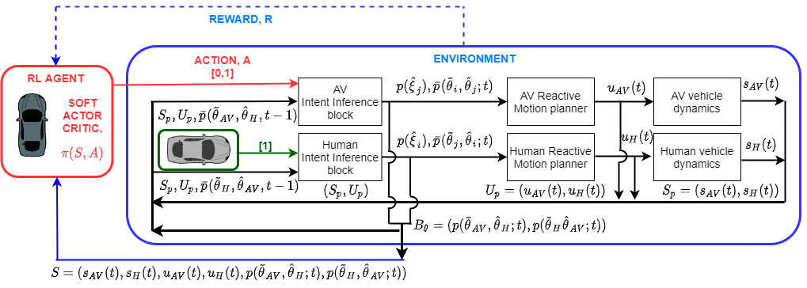
Intermittent Intent Inference via Reinforcement Learning
Computing intent inference online computationally expensive and does not provide additional information ¹
Our proposed RL based intermittent intent inference framework determines if the agent should carry out belief update or not.
February 27-28, 2020 | ARLINGTON, VIRGINIA
Amatya, S., Ghimire, M., Ren, Y., Xu, Zhe., Zhang, W., “When Shall I Estimate Your Intent? Costs and Benefits of Intent Inference in Multi-Agent Interactions”, American Control Conference 2022 (ACC)

Slide 6
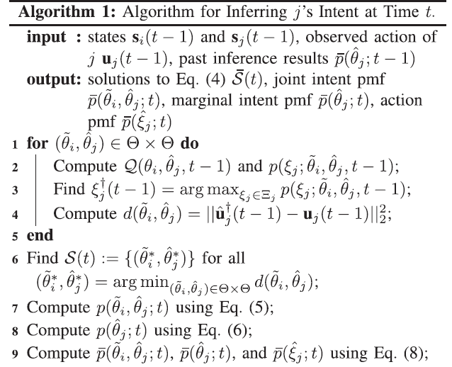
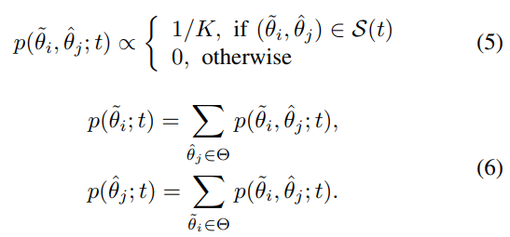
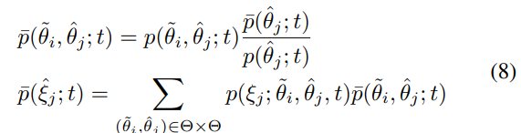
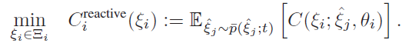
Mathematical formulation
Belief Transition
Motion Planner
Wang, Y., Ren, Y., Elliott, S., Zhang, W., “Enabling courteous vehicle interactions through game-based and dynamics-aware intent inference”, IEEE Transactions on Intelligent Vehicles 5 (2), 217-228 (2020)
Ren, Y., Elliott, S., Wang, Y., Yang, Y., Zhang, W., “How shall I drive? Interaction modeling and motion planning towards empathetic and socially-graceful driving”, 2019 International Conference on Robotics and Automation (ICRA), 4325-4331
Notes:
Joint belief update is carried out, for all combination of intent we find the nash equilibrium solution and probability of state of the other agent.
The inference problem is solved by finding the resulting motion of the other agent with the highest probability mass at time previous timestep.
Each solution is S(t) is assigned equal probability, hence joint probability and marginal probability is calculated.
After which bayes rule is used to update the marginal probability and in the similar manner joint probability distribution of belief and the of the estimated trajectory is updated.

Slide 7
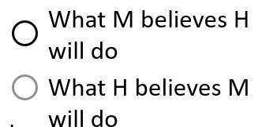
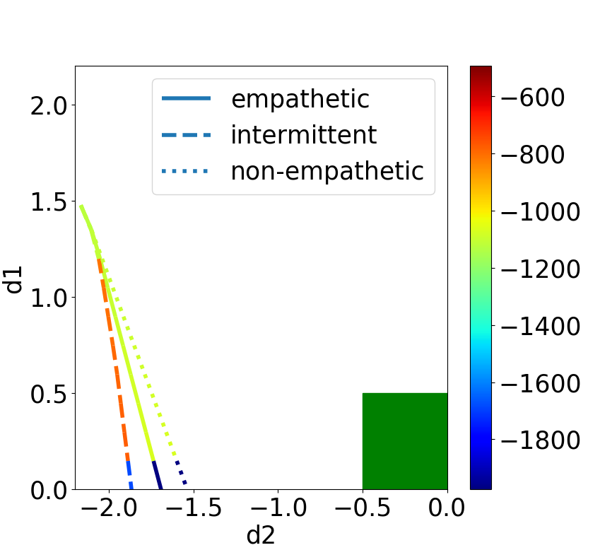
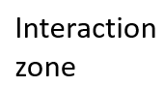
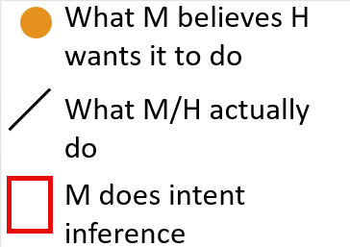
Advantage of Empathy
Intermittent AV runs belief update until the intent of Human is determined
February 27-28, 2020 | ARLINGTON, VIRGINIA
d2
Human
Human
d1
AV
AV
Empathetic AV decelerates in the beginning to create more courteous motion
Non-Empathetic AV maintains a constant velocity leading to closer distance between vehicles
Reward Graph for three intent inference case
Amatya, S., Ghimire, M., Ren, Y., Xu, Zhe., Zhang, W., “When Shall I Estimate Your Intent? Costs and Benefits of Intent Inference in Multi-Agent Interactions”, American Control Conference 2022 (ACC)

Slide 8
Intermittent Empathetic: Cost and Benefits
Parameters | Empathetic | Non-Empathetic | Intermittent
Memory (KB) | 3.11±0.28 | 2.95±0.95 | 1.27±0.34
Time (s) | 291.47±46.79 | 155.20±14.62 | 170.32±14.18
Value | -1.14e5 ±6.58e3 | -1.32e5 ±6.37e3 | -1.09e5 ±4.17e3
Distance | 1.43±0.05 | 1.33±0.07 | 1.42±0.15
February 27-28, 2020 | ARLINGTON, VIRGINIA
Intermittent Intent Inference performs similar navigations as compared to the continuous inference algorithm while saving significant memory and time
Amatya, S., Ghimire, M., Ren, Y., Xu, Zhe., Zhang, W., “When Shall I Estimate Your Intent? Costs and Benefits of Intent Inference in Multi-Agent Interactions”, American Control Conference 2022 (ACC)

Slide 9

Thank you
February 27-28, 2020 | ARLINGTON, VIRGINIA
Sunny Amatya (Samatya@asu.edu)
Wenlong Zhang (Wenlong.Zhang@asu.edu)
https://home.riselab.info/
https://home.riselab.info/nri.html
This material is based on the work supported in part by the National Science Foundation (NSF) under NSF Award Number 1925403. Any opinions, findings and conclusions, or recommendations expressed in this material are those of the author(s) and, do not necessarily reflect those of the NSF.

